Slide 1
HAND DISTANCE MEASUREMENT
By:aditya jadhav
Under the guidance of Prof. RithIk Raj Vaishya

Slide 2
Introduction:
The Hand Distance Measurement project uses Google's Media Pipe library to accurately detect hand landmarks and compute the distance between the tip of the thumb and the tip of the index finger.
The distance is then converted into centimeters using a pre-calibrated polynomial regression model.
It provides a user-friendly interface to visualize the hand landmarks and the computed distance in real-time, making it useful for various virtual environments and gesture-based control systems.

Slide 3
Feature:
Real-time hand landmark detection using the powerful Media Pipe framework.
Precise calculation of the distance between two specific hand landmarks.
Visualization of the hand landmarks and bounding box on the video stream.
Interactive display of the computed distance in centimeters on the video feed.

Slide 4
METHODOLOGY:
The methodology revolves around a sequence of steps to be followed in order to reach to our project
Initialization
Data Preparation
Video Capture
Main Loop
Display
Exit Condition

Slide 5
Required libraries:
Open CV : Image and video processing, including capturing, frame processing, drawing, and display.
Math Library: Mathematical operations, distance calculation.
Media Pipe : Machine learning for perceptual data processing, such as hand detection and tracking.
NumPy : Numerical computing, featuring array manipulation and mathematical functions, utilized for polynomial regression in this code.

Slide 6
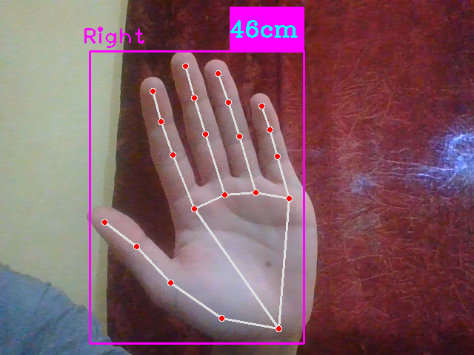
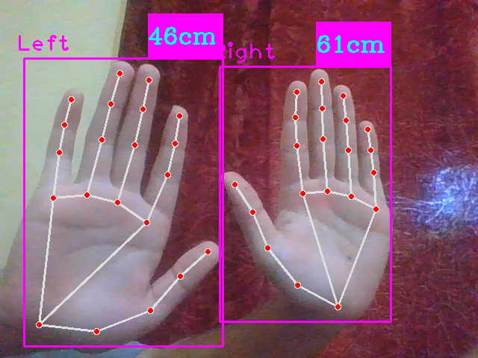
Project Output:

Slide 7
Conclusion:
Hand distance measurement system using Media Pipe provides a reliable way to
calculate distances between hand landmarks in real-time video.
By combining computer vision and machine learning techniques,
it offers accurate results.

Slide 8
THANK-YOU

